Slide 1
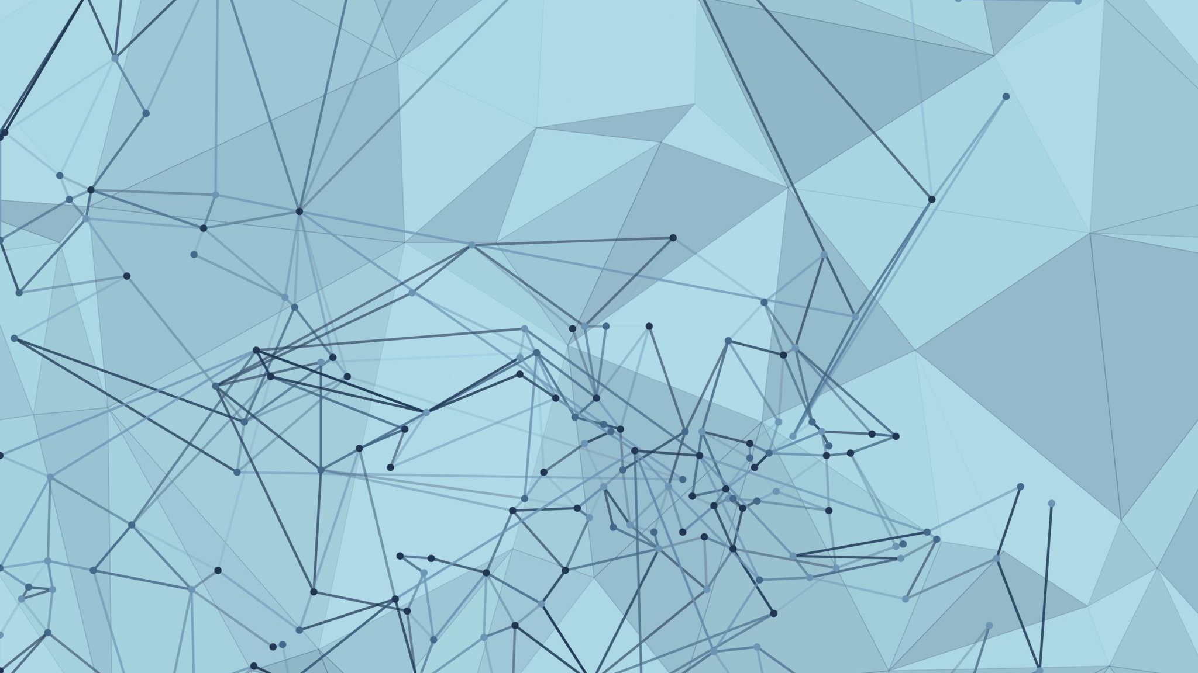
Deep Learning
Qishi Machine Learning Study Group

Slide 2
Table of Contents
CPU and GPU
Parallelization
Gradient Vanishing/Exploding
CNN
AlexNet
ResNet

Slide 3
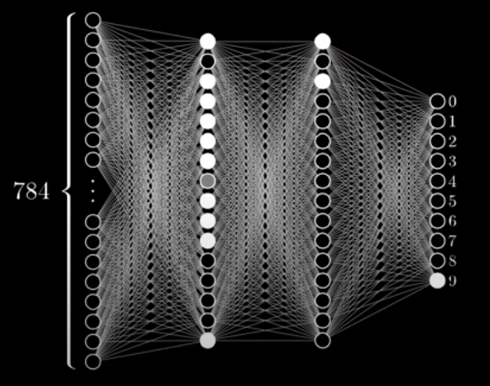
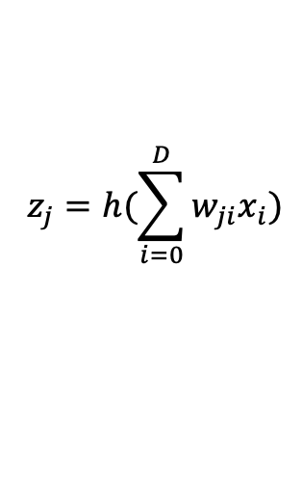
Neural Network
$$z_{j}=h(\sum_{i=0}^{D}{w_{ji}x_{i})}$$
Forward propagation; backward propagation

Slide 4
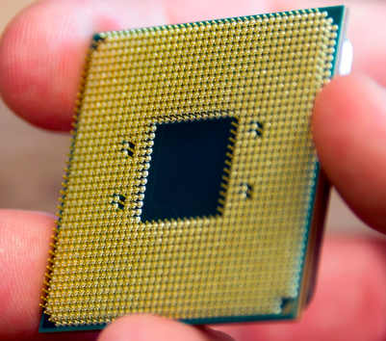
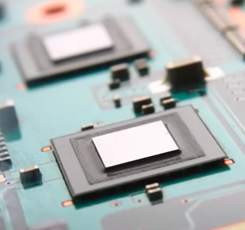
CPU vs GPU
CPU
GPU

Slide 5
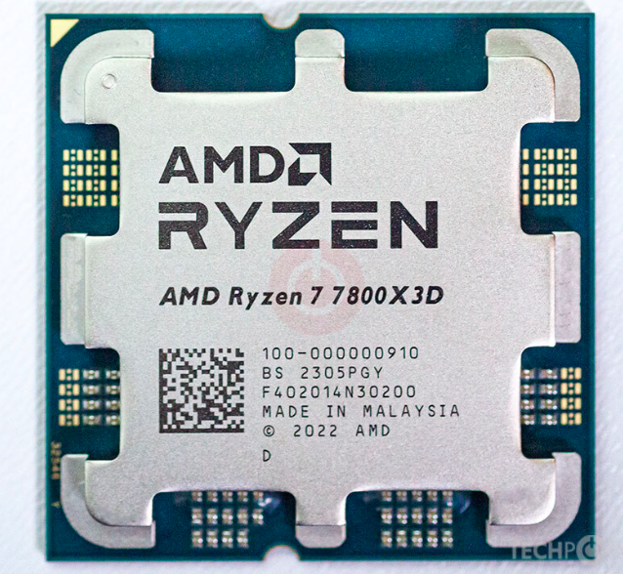
CPU vs GPU
CPU
https://www.techpowerup.com/cpu-specs/ryzen-7-7800x3d.c3022
Released: Jan 4th, 2023
Die size: 71 mm² (roughly 8.5cm*8.5cm)
Transistors: 6,570 million
Price: $450

Slide 6
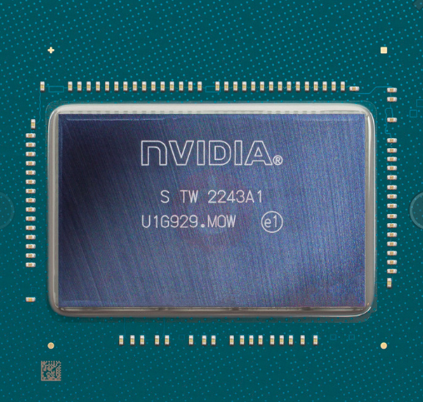
CPU vs GPU
GPU
https://www.techpowerup.com/gpu-specs/nvidia-ad103.g1012
Released: Sep 20th, 2022
Die Size: 379 mm² (roughly 2cmx2cm)
Transistors: 45,900 million
Price: $1200 (graphics card)

Slide 7
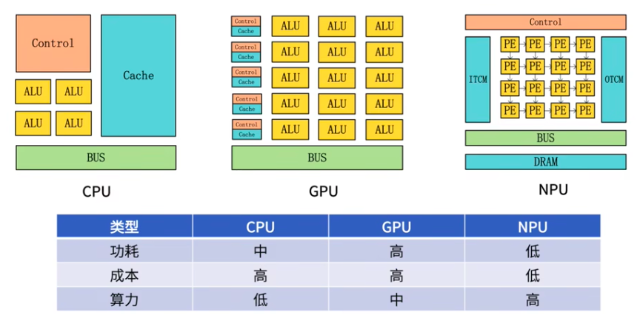
Why don’t we use 100 CPUs instead?
The architecture / Integrated Circuit is different

Slide 8
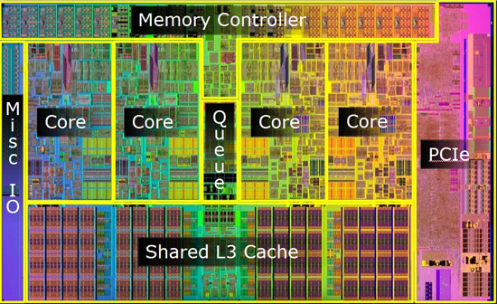
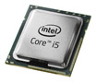
CPU Die Shot
Intel Core i5

Slide 9
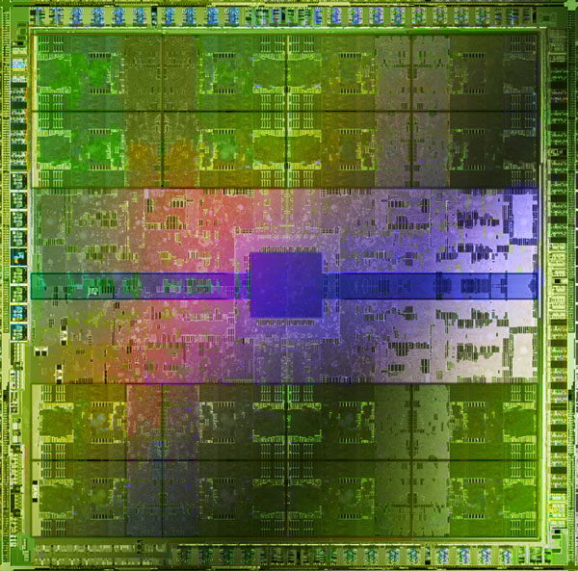
GPU die shot
NVIDIA GF100

Slide 10
Moore's law
Moore's law is the observation that the number of transistors in an integrated circuit doubles about every two years.
Modern transistors are around 7nm wide
Silicon's atomic size is about 0.2 nanometers. Today's transistors are about 35 silicon atoms wide, so the possibility of making them even smaller is itself shrinking. We're getting very close to the limit of how small we can make a transistor.

Slide 11
CPU vs GPU
CPU: Central Processing Unit
Main providers: Intel and AMD
control unit, the arithmetic logic unit, and the cache memory
the brain of a computer, containing all the circuitry needed to process input, store data, and output results
GPU: Graphics Processing Unit
Main providers: NVIDIA and AMD
shader units, texture mapping units, and etc.
mainly used for: machine learning, video editing, and gaming applications
https://youtu.be/-P28LKWTzrI

Slide 12
CPU vs GPU
Similarities
Both are silicone-based microprocessors
Both are made up of transistors arranged in complex patterns to form various parts
Differences
CPUs process data sequentially; the design focus is on single-threaded performance and power efficiency
GPUs are designed for parallel processing and have specialized architecture and processing power for graphics-intensive tasks
CPUs have a limited number of processing cores compared to GPUs
CPUs have lower memory bandwidth compared to GPUs, which can limit their ability to quickly access and manipulate data
Memory bandwidth is the rate at which data can be read from or stored into a semiconductor memory by a processor.

Slide 13
Why is GPU Efficient
GPUs have many small processing cores that can handle many tasks simultaneously
GPUs have a specialized architecture optimized for graphics processing
GPUs have high memory bandwidth, which enables them to quickly read and write data to and from memory
GPUs have their own dedicated memory, which allows them to store and access data more efficiently

Slide 14
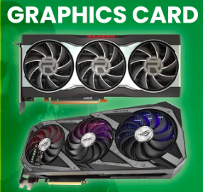
GPU vs Graphics Card

Slide 15
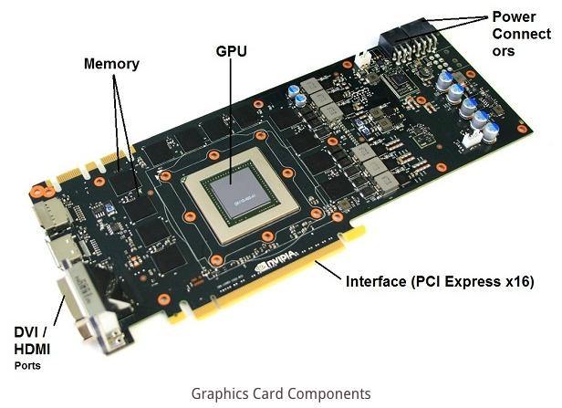
GPU vs Graphics Card

Slide 16
GPU vs Graphics Card
GPU: specialized electronic circuit designed to quickly manipulate and alter memory to accelerate the creation of images in a frame buffer intended for output to a display device
Graphics card: a hardware component that contains one or more GPUs, video memory, and other specialized circuitry to perform the necessary calculations to generate images and display them on a screen
The graphics card includes a GPU as one of its key components.
The GPU is responsible for performing the vast majority of the graphics-related processing that occurs within a computer system.

Slide 17
Why is GPU good for deep learning?
Although GPUs were originally designed for computer graphics, they are also well-suited for performing many mathematical operations in parallel. This makes them an excellent choice for accelerating the training of deep neural networks, which involve large amounts of matrix operations that can be parallelized
e.g. say a human arm is modeled as a block, the movement of the block in space is modeled as matrix transformation
Memory bandwidth - including GPUs can provide the bandwidth needed to accommodate large datasets. This is because GPUs include dedicated video RAM (VRAM), enabling you to retain CPU memory for other tasks
Dataset size - GPUs in parallel can scale more easily than CPUs, enabling you to process massive datasets faster. The larger your datasets are, the greater benefit you can gain from GPUs

Slide 18
FLOP
FLOP：floating-point operations, a measure of the computational complexity of an algorithm. it represents the number of floating-point operations that required to execute the algorithm. Floating-point operations involve mathematical calculations with real numbers that have decimal points.
FLOPS is a measure of how many floating-point calculations a computer or GPU can perform in one second. The more FLOPS a GPU can perform, the faster it can perform complex calculations, and the better it can handle tasks such as image processing, video encoding, and scientific simulations.
In deep learning, the performance of a neural network is typically measured by the number of FLOPS required to perform a forward pass. This metric can be used to compare the performance of different neural network architectures and to optimize the design of neural networks for specific tasks.

Slide 19
NPU (neural processing unit )
A microprocessor that specializes in the acceleration of machine learning algorithms, typically by operating on predictive models such as artificial neural networks (ANNs) or random forests (RFs)
AKA neural processor
Some real-life implementations of Neural Processing Units (NPU) are:
TPU by Google
NNP, Myriad, EyeQ by Intel
NVDLA by Nvidia
AWS Inferentia by Amazon
Ali-NPU by Alibaba
Kunlun by Baidu
Sophon by Bitmain
MLU by Cambricon
IPU by Graphcore
Ascend by Huawei
Neural Engine by Apple
Neural Processing Unit (NPU) by Samsung
NPUs on Tesla cars

Slide 20
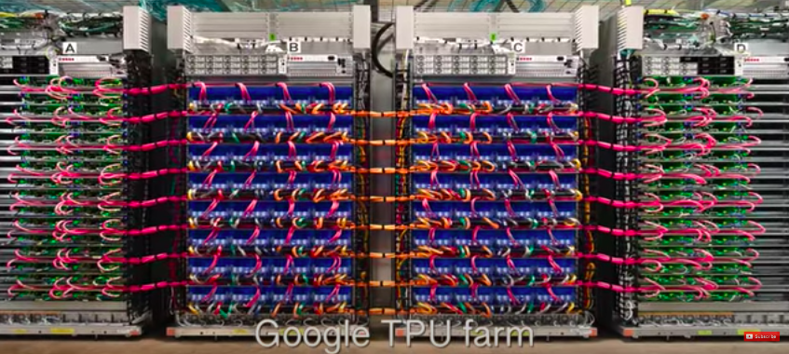
TPU (tensor processing unit)

Slide 21
NPU (neural processing unit )

Slide 22
Why don’t we use NPUs instead of GPUs?
GPUs are more accessible for retail consumers
GPUs are relatively cheaper because of economy of scale
As more NPUs get produced the cost might go down and make them more available to the general public

Slide 23
Types of Parallelism
Type of Parallelism | Explanation
Inter-model parallelism | This refers to the parallel execution of different models or sub-models, with each running on a separate device or node. This can help to distribute the workload and reduce training time.
Data parallelism | This refers to the parallel execution of the same model on different subsets of the training data. Each subset is processed by a separate device or node, and the results are combined to update the model parameters. This can help to speed up training and improve scalability.
Intra-model parallelism | This refers to the parallel execution of different parts of the same model on separate devices or nodes, each handling a different portion of the model's computation. This can help to reduce the memory requirements of training and improve performance on large models.

Slide 24
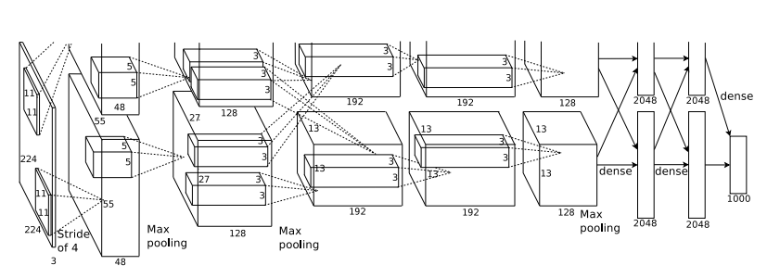
AlexNet Intra-model parallelism

Slide 25
Types of Parallelism
Type of Parallelism | Explanation
Pipeline parallelism | Run different layers of the model on different GPUs
Tensor parallelism | Break up the math for a single operation such as a matrix multiplication to be split across GPUs
Mixture-of-Experts | Have many sets of weights and the network can choose which set (“expert”) to use via a gating mechanism at inference time. This enables many more parameters without increased computation cost. Different experts can be hosted on different GPUs, providing a clear way to scale up the number of GPUs used for a model.
https://openai.com/research/techniques-for-training-large-neural-networks

Slide 26
How to implement parallelization?
Tools
Python (with frameworks such as TensorFlow, PyTorch, and MXNet)
CUDA (with CUDA C++ for highly optimized GPU code)
OpenCL (with support for multiple programming languages)
Julia (with built-in support for parallel computing on multiple GPUs)
C++ (with APIs provided by deep learning frameworks such as Caffe and Torch)
多GPU训练实现 #PyTorch #李沐 https://www.bilibili.com/video/BV1MQ4y1R7Qg
How to scale training on multiple GPUs
https://towardsdatascience.com/how-to-scale-training-on-multiple-gpus-dae1041f49d2

Slide 27
Gradient Vanishing/Explosion
Gradient Vanishing
When there are more layers in the network, the value of the product of derivative decreases until at some point the partial derivative of the loss function approaches a value close to zero, and the partial derivative vanishes.
Gradient Explosion
If the gradients are large, the multiplication of these gradients will become huge over time. This results in the model being unable to learn and its behavior becomes unstable.
The explosion occurs through exponential growth by repeatedly multiplying gradients through the network layers that have values larger than 1.0.

Slide 28
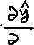









Recap - Backpropagation
?

Slide 29
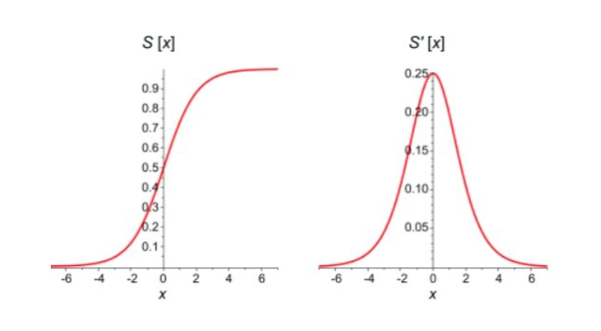
Gradient Vanishing
Why?
Too many layers
Used activation functions such as Sigmoid
First derivatives of sigmoid functions are bell curves with values ranging from 0 to 0.25.

Slide 30
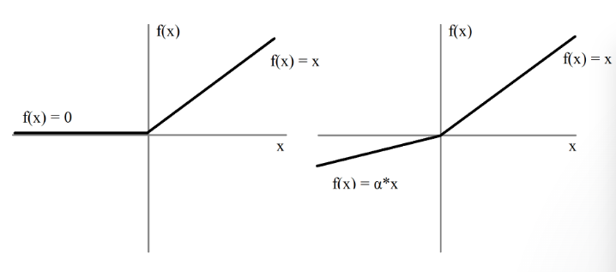
Gradient Vanishing
How to avoid gradient vanishing
Change activation to ReLu / Leaky ReLu
The problem with the use of ReLU is when the gradient is 0. In such cases, the node is considered as a dead node since the old and new values of the weights remain the same. This situation can be avoided by using a leaky ReLU.
Change model: fewer layers; LSTM; ResNet; and etc.

Slide 31
Gradient Explosion
Why
Too many layers
Initial weights too large
How to avoid gradient explosion
Change model: fewer layers, LSTM, and etc.
Regularization
Gradient clipping: limit the size of gradients during the training of your network

Slide 32
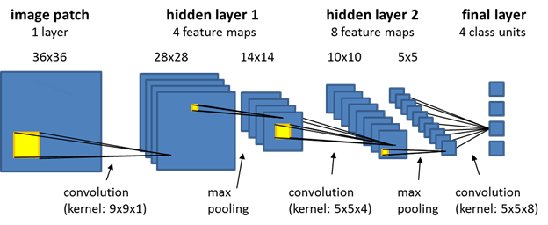
CNN – Convolutional Neural Networks

Slide 33

CNN - Convolution
Convolution example: a 3x3 filter; this feature is shaped like “X”

Slide 34
CNN - Convolution
kernel (a.k.a. a filter or a feature detector): a small matrix of weights that is used to scan the input data
Filters are used in CNNs to extract features from input data such as images, which are then used to make predictions or classifications
Kernels are learned through model training, it’s NOT a manual process. The weights of the kernels are learned during training using backpropagation.
By adjusting the filter weights, the CNN can learn to identify different features in the input data such as edges, corners, shapes, and textures.
Feature detectors help build up a hierarchy of features in the CNN, where lower-level filters detect basic features such as edges and corners, and higher-level filters detect more complex features such as shapes and textures.

Slide 35
CNN - Convolution
kernel (a.k.a. a filter or a feature detector): a small matrix of weights that is used to scan the input data
Filters are used in CNNs to extract features from input data such as images, which are then used to make predictions or classifications
Kernels are learned through model training, it’s NOT a manual process. The weights of the kernels are learned during training using backpropagation.
By adjusting the filter weights, the CNN can learn to identify different features in the input data such as edges, corners, shapes, and textures.
Feature detectors help build up a hierarchy of features in the CNN, where lower-level filters detect basic features such as edges and corners, and higher-level filters detect more complex features such as shapes and textures.

Slide 36
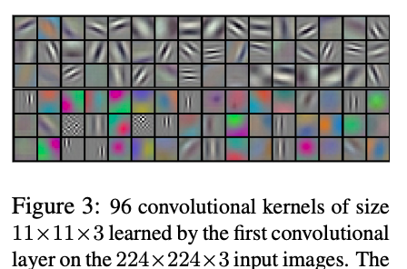
CNN - Convolution
Filters learned by AlexNet

Slide 37
CNN - Feature Map/Channels
Channels (a.k.a. feature maps) :
a way of representing the output of a convolutional layer. Each channel corresponds to a particular filter that has been applied to the input data, and contains the responses of that filter at every position in the input
a channel represents a particular aspect or feature of the input data, e.g. edges, textures, or colors
The number of channels in a convolutional layer is a hyperparameter that needs to be set before training the network (similar to the number of neurons in each layer in a “plain vanilla” neural network, where the hyperparameter is determined before training)
To flatten multiple channels in a CNN, simply concatenate the output of each channel into a single long vector

Slide 38
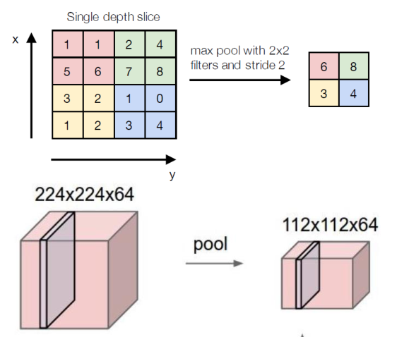
CNN - Pooling
Pooling: downsampling operation; reduces the width and height of the input feature map, while preserving the depth (number of channels)
Lowers data size while preserving features
Max pooling
Average pooling

Slide 39
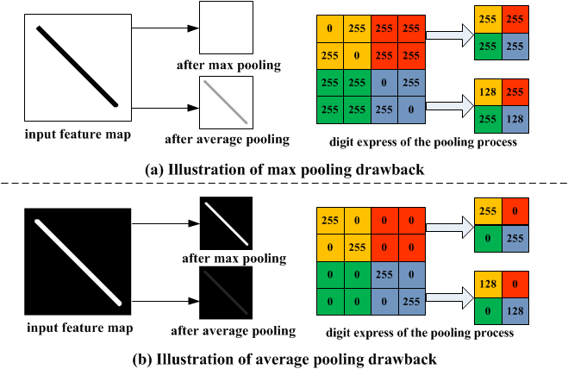
CNN - Pooling

Slide 40
CNN
Zero padding: adding extra rows and columns of zeros around the border of the input image or feature map; reduces the likelihood of losing important features at the edges; preserves the spatial dimensions of the input image
stride: the number of pixels by which the kernel is shifted (or "slid") across the input data

Slide 41
CNN - fully connected layers
Flatten layer: a layer used to convert the output of the previous convolutional or pooling layer into a one-dimensional array (or vector), which can then be passed to a fully connected layer.
Dense layers (fully connected layers): a fully connected layer that follows the convolutional and pooling layers
There may be multiple fully connected layers, after a number of convolutional and pooling layers. Every single neuron of the current layer is connected with all the neurons in the previous layer.
The last layer of CNNs is an output layer that makes final predictions. For classification tasks, the Softmax function is commonly used where multiple classes are targeted for prediction and the Sigmoid function is used for binary classification.

Slide 42

CNN
Channels:

Slide 43
AlexNet
When?
Who came up with this?
What is it?
What does it do?
Why important?
What were the improvements?
How does it work?
What can be improved?
What are some example use cases?

Slide 44

AlexNet
ImageNet classification with deep convolutional Neural Networks
When?
2012
Who came up with this?
University of Toronto - Alex Krizhevsky, Ilya Sutskever, Geoffrey E. Hinton
What is it?
It’s a Convolutional Neural Network architecture (60 million parameters, 65k neurons)
What does it do?
It was a model used to perform classification tasks using ImageNet data (1.2 million images, 1000 classes)

Slide 45


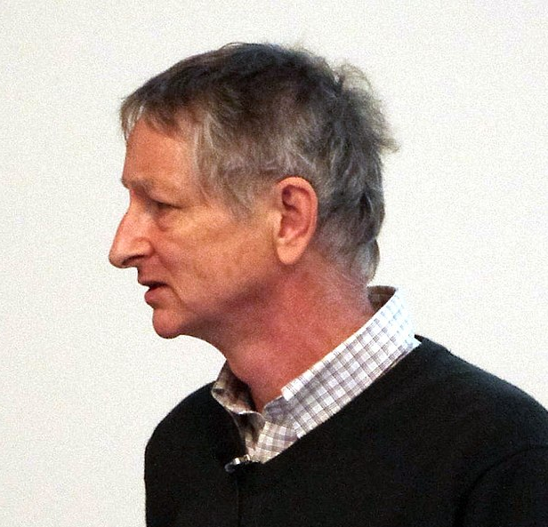
AlexNet

Slide 46
AlexNet
Why important?
Achieved a top-5 error of 15.3% in the ImageNet 2012 Challenge, more than 10.8 percentage points lower than that of the runner up
Groundbreaking - the first deep neural network that demonstrated superior performance in image classification c.f. traditional ML algorithms
Paved the way for the development of deeper and more complex neural networks, such as VGG, ResNet, and Inception
end-to-end pipeline, no more feature extraction
Led to a renewed interest in deep learning
What were the improvements?
Data augmentation: crop, modify RGB using PCA
Used dropout (50%) to reduce overfitting
ReLU instead of Sigmoid (to reduce gradient vanishing)

Slide 47
AlexNet

Slide 48
AlexNet
How does it work?
Input: raw RGB image of size 256x256 pixels
Output: image classes, such as mushroom, cherry, leopard
The design:
five convolutional layers and three fully connected layers
ReLu activation function
Max pooling instead of average pooling
Training
Weight initialization: gaussian, mean 0, standard deviation 0.01
Bias initialization: 1 for layers 2, 4, 5; 0 for the rest of the layers
dropout (50%) – different neurons get dropped out for diff sample; samples share same weights
Learning rate: 0.01; divide the learning rate by 10 when the validation error rate stopped improving with the current learning rate
SGD

Slide 49
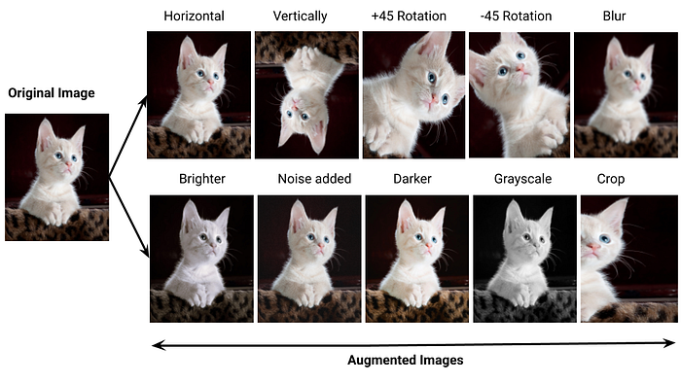
AlexNet

Slide 50
AlexNet
Image preprocessing:
raw data - RGB image of size 256x256 pixels
randomly crop 224x224 patches from the raw data
randomly crop 224x224 patches from the horizontal reflections of the raw data

Slide 51

Learning Rate

Slide 52
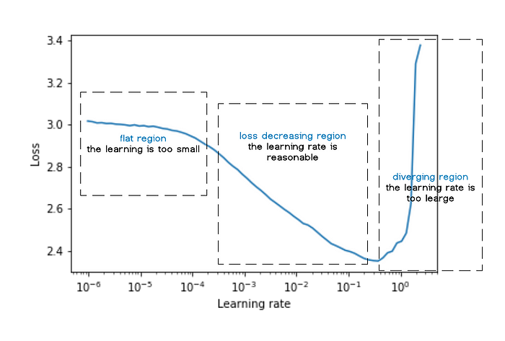
Learning Rate

Slide 53
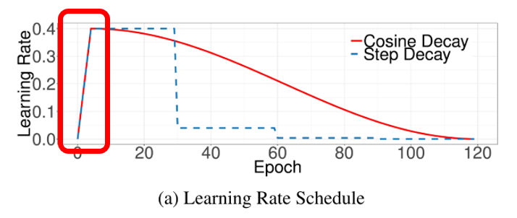
Learning Rate

Slide 54
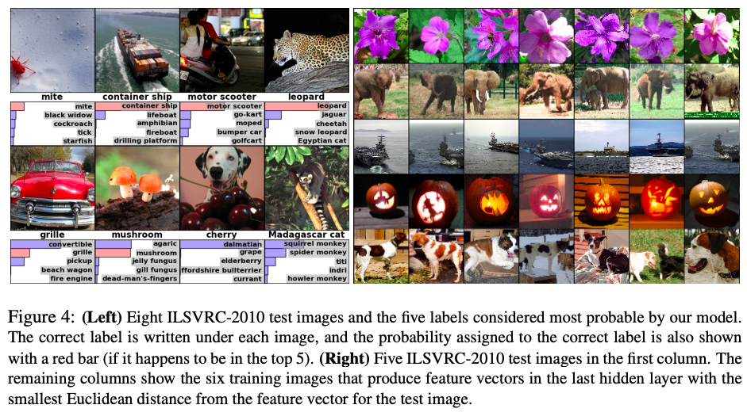
AlexNet

Slide 55
AlexNet
What can be improved?
AlexNet is NOT deep enough compared to the later model, such as VGGNet, GoogLENet, and ResNet
The use of large convolution filters (5*5) is not encouraged shortly after that
Use of normal distribution to initiate the weights can not effectively solve the problem of gradient vanishing, replaced by the Xavier method later
What are some example use cases?
Image classification
Large-scale visual recognition
Transfer learning
Object detection
Medical imaging

Slide 56
ResNet (Residual Network)
When?
Who came up with this?
What is it?
What does it do?
Why important (advantages)?
How does it work?
What are the drawbacks?
What are some example use cases?

Slide 57
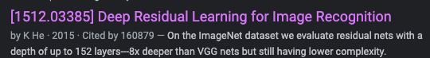
ResNet
Deep Residual Learning for Image Recognition https://arxiv.org/abs/1512.03385
When?
2015
Who came up with this?
Microsoft: Kaiming He, Xiangyu Zhang, Shaoqing Ren, Jian Sun
What is it?
It’s a convolutional neural network architecture (up to 152 layers)
What does it do?
Image classification; won the ImageNet 2015 Challenge

Slide 58

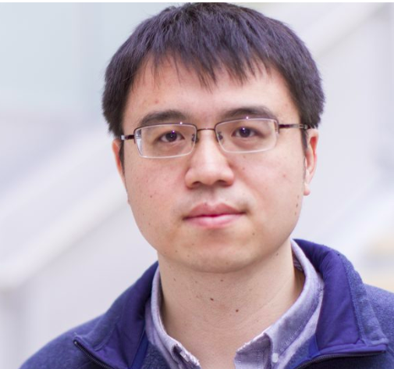


ResNet

Slide 59
ResNet
Deeper neural network = better results?

Slide 60
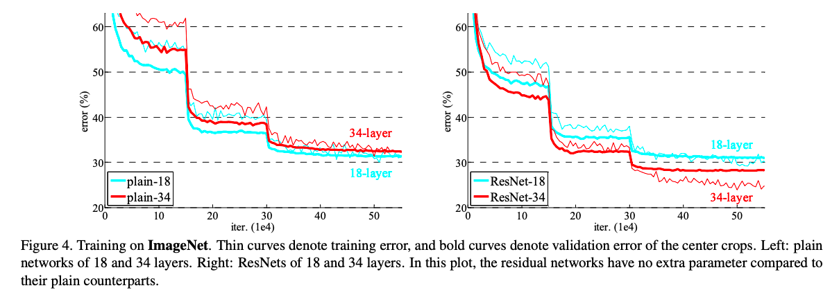
ResNet

Slide 61
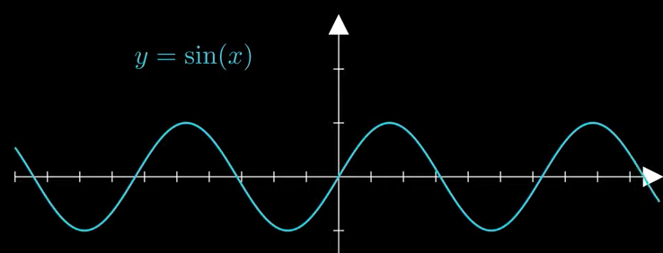
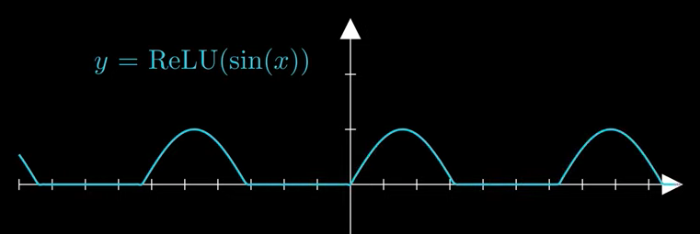
ResNet

Slide 62
ResNet
Some information is lost by using ReLU as the activation function
Why don’t we just get rid of activation functions?
Activation functions introduce non-linearity to neural networks, which is essential for learning complex and non-linear relationships in the data
ReLU has been shown to work well in many practical applications
gradient vanishes due to the chain rule of differentiation; getting rid of the activation function would only fix part of the issue but not all

Slide 63
ResNet
Why is ResNet important?
Achieved state-of-the-art performance on the ImageNet 2015 challenge
Resolves the problem that deeper neural networks are not able to outperform shallower networks
Introduces residual connections which can help to alleviate the vanishing gradient problem and make it easier to train deeper networks
It allows for the training of much deeper networks
Led to significant improvements in performance on a wide range of computer vision tasks, such as image classification, object detection, and semantic segmentation

Slide 64
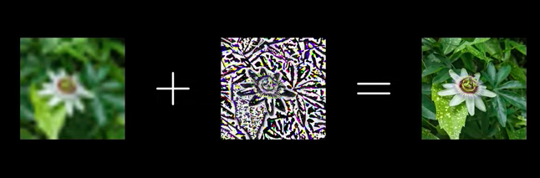
ResNet

Slide 65
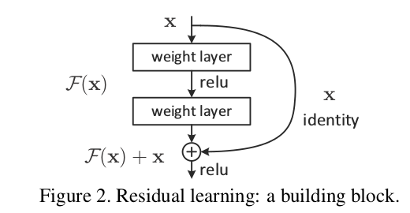
ResNet – Residual blocks
Skip connection (a.k.a. residual connections/ shortcut connection/ identity connection): allows information to bypass one or more layers of the network.
Uses skip connections to create shortcuts between the input and output of its layers

Slide 66
ResNet – Residual blocks
In the original ResNet paper, the skip connections are designed to skip two layers, specifically the two convolutional layers within a residual block.
This design choice was based on empirical observations and experimentation. It was found that skipping one layer was not sufficient to fully address the vanishing gradient problem, while skipping more than two layers could negatively affect the accuracy of the model.

Slide 67
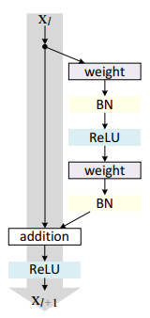
ResNet – Residual blocks

Slide 68
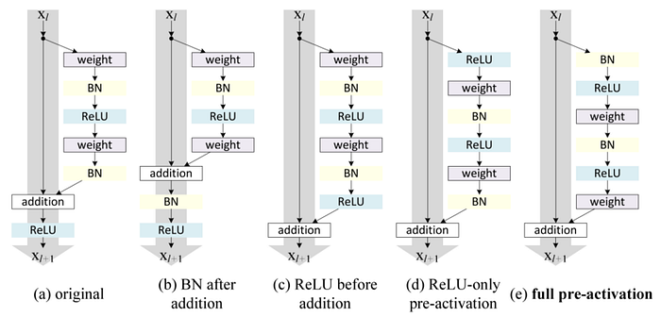
ResNet – Residual blocks
Types of residual blocks

Slide 69
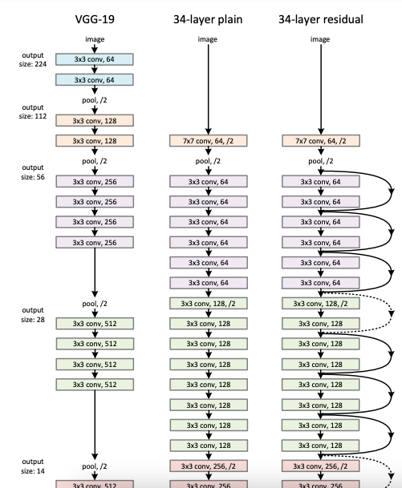
ResNet

Slide 70
ResNet
How does ResNet work?
uses skip connections to create shortcuts between the input and output of its layers
residual block adds the input of a layer to its output
uses multiple residual blocks in a deep neural network architecture
batch normalization
match dimensions by using 1x1 convolution (see appendix)
A 1 x 1 Convolution with stride 2 to reduce image size by half and doubles the number of channels
did not use dropout

Slide 71
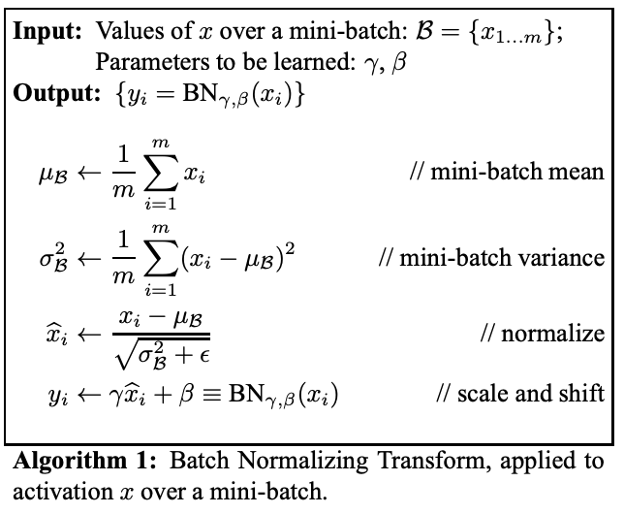
ResNet
Batch normalization:

Slide 72
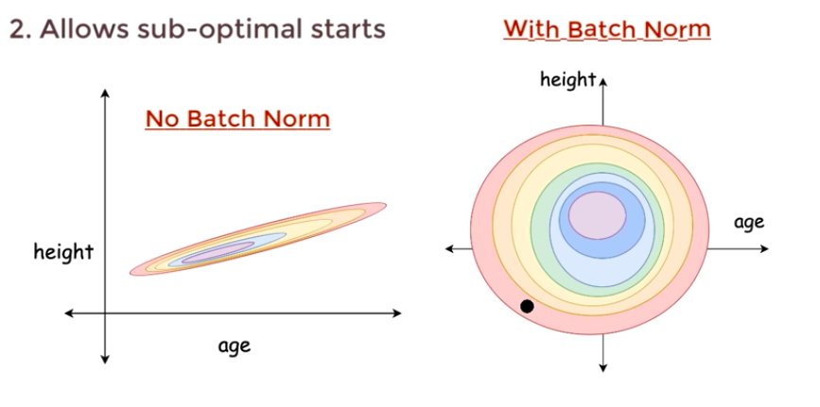
ResNet
Batch normalization:
Sergey Ioffe and Christian Szegedy, 2015
Normalizing the mean and variance of each mini-batch of activations
Reduces internal covariate shift
the distribution of inputs to a neural network changes as the network is trained, leading to the network's internal activations also changing
Faster training time, improved model generalization, increased stability during training
Having different mean and variance across mini-batches is expected and intentional

Slide 73
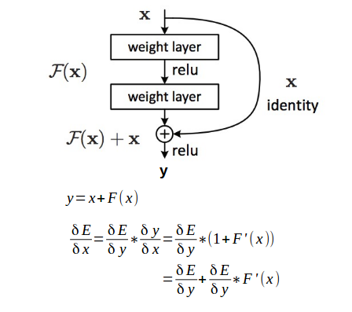
ResNet
Backpropagation

Slide 74
ResNet
What are the drawbacks?
ResNet can be computationally expensive, especially for very deep networks.
The skip connections can sometimes lead to overfitting if not properly regularized.
The increased complexity of ResNet can make it more difficult to interpret or understand how the network is making its predictions.
ResNet may not perform as well on tasks that require spatial information, such as image segmentation, compared to other architectures like U-Net.

Slide 75
ResNet
What are some example use cases?
Image classification
Object detection
Face recognition
Autonomous vehicles
Medical imaging
Robotics

Slide 76
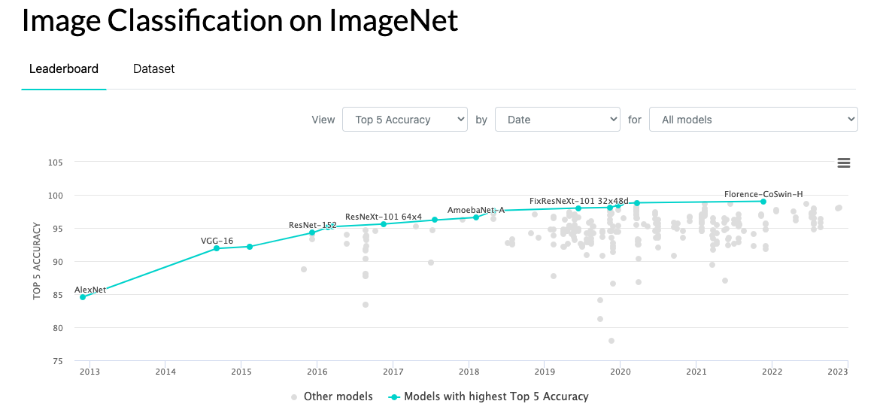
Accuracy by Year

Slide 77
Observations
Computational power is growing
Neural Networks are getting deeper and deeper
Scientists keep enhancing existing models and inventing new models

Slide 78


Slide 79
Appendix – 1x1 convolution
Here's a simple example of how a 1x1 convolution works mathematically.
Suppose we have an input tensor X of shape (4, 4, 3), where the first two dimensions correspond to the height and width of the input image, and the third dimension corresponds to the number of channels. That is, we have an input image of size 4x4 with 3 channels (e.g., red, green, and blue).
X = [ [ [ 1, 2, 3 ], [ 4, 5, 6 ], [ 7, 8, 9 ], [ 10, 11, 12 ] ], [ [ 13, 14, 15 ], [ 16, 17, 18 ], [ 19, 20, 21 ], [ 22, 23, 24 ] ], [ [ 25, 26, 27 ], [ 28, 29, 30 ], [ 31, 32, 33 ], [ 34, 35, 36 ] ], [ [ 37, 38, 39 ], [ 40, 41, 42 ], [ 43, 44, 45 ], [ 46, 47, 48 ] ] ]
Now suppose we apply a 1x1 convolution with 2 filters to this input tensor. That is, we apply a convolution operation that involves multiplying each pixel in the input tensor by a 1x1 filter with 2 channels, and then summing the results to produce a new tensor of shape (4, 4, 2). Let the weights of the 1x1 filter be denoted by W.
The convolution operation can be written as follows:

Slide 80
Appendix – 1x1 convolution
Y[i, j, k] = sum( X[i, j, c] * W[c, k] for c in range(3) )
where Y is the output tensor, and i, j, and k are indices over the height, width, and channel dimensions of the output tensor, respectively.
For example, to compute the value of Y[1, 2, 0], we would use the following formula:
Y[1, 2, 0] = sum( X[1, 2, c] * W[c, 0] for c in range(3) ) = X[1, 2, 0] * W[0, 0] + X[1, 2, 1] * W[1, 0] + X[1, 2, 2] * W[2, 0]
where X[1, 2, 0] = 19, X[1, 2, 1] = 20, X[1, 2, 2] = 21, W[0, 0] is the weight of the first channel of the first filter, and so on.
After applying the 1x1 convolution with 2 filters, we get the output tensor Y of shape (4, 4, 2), which might look something like this:
Y = [ [ [ 46.5, 72.5 ], [ 49.5, 77.5 ], [ 52.5, 82.5 ], [ 55.5, 87.5 ] ], [ [ 118.5, 144.5 ], [ 121.5, 149.5 ], [ 124.5, 154.5 ], [127.5, 159.5 ] ], [ [ 190.5, 216.5 ], [ 193.5, 221.5 ], [ 196.5, 226.5 ], [ 199.5, 231.5 ] ], [ [ 262.5, 288.5 ], [ 265.5, 293.5 ], [ 268.5, 298.5 ], [ 271.5, 303.5 ] ] ]

Slide 81
Appendix – 1x1 convolution
Each element of the output tensor `Y` is obtained by multiplying the corresponding pixel in the input tensor `X` by the weights in the 1x1 filter `W`, and then summing the results across all input channels.
In this example, the output tensor `Y` has two channels (one for each filter), and each channel contains a new representation of the input image with a lower number of channels. This can be useful for reducing the computational cost of subsequent convolutional layers while still preserving important features of the input image.

